Slide 1
Smart Agriculture
Submitted in the partial fulfillment for the award of the degree of
BACHELOR OF ENGINEERING
IN
Airtificial Intellegence and Machine Learning
Submitted by: Abhay Vershwal (21BCS6347)
Vansh Yadav (21BCS6374)
Vaibhavi Joshi(21BCS8330)
Abhimanyu Saini(21BCS8255)
Under the Supervision of:
Mr.Nirmalya Basu
Department of AIT-CSE
DISCOVER . LEARN . EMPOWER

Slide 2
Outline
Introduction to Project
Problem Formulation
Objectives of the work
Methodology used
Results and Outputs
Conclusion
Future Scope
References

Slide 3
Introduction to Project
“SMART AGRICULTURE”
Agriculture is a critical industry for sustaining human life.
Smart agriculture leverages advanced technologies to improve efficiency and sustainability in farming practices.
Aim: Detect and eliminate plant diseases early, supporting farmers with the idea of "Early Stage Disease Detection" project.
Mordern
Traditional

Slide 4
Problem Formulation
Agriculture challenges: Population growth brings land constraints, diseases, and water scarcity. Industrilizationa and Mordern Civilization addresses these issues in real-time.
Field weed detection: Plant diseases, insect and pests reduce crop yield nearly cause 15-25% loss for which farmers have to suffer and affect the overall profit .
Plant diseases and pathogens: Pathogens are the primary cause of plant diseases. And it is very difficult for the farmer to move around all the feild and find the infected area , so he pour pesticide all over the feild.

Slide 5
Objectives of the Work
Goal of the study: Early detection of crop diseases using machine learning to aid farmers in prompt treatment and minimizing crop loss.
Utilizing drones and software/app: High-resolution crop photos help identify diseases and notify farmers about potential issues, suggesting suitable treatments or methods.
Benefits of technology: Farmers gain knowledge about crop diseases at an early stage, reducing the need for unnecessary pesticides and improving agricultural productivity while preserving land for future productive harvests.

Slide 6
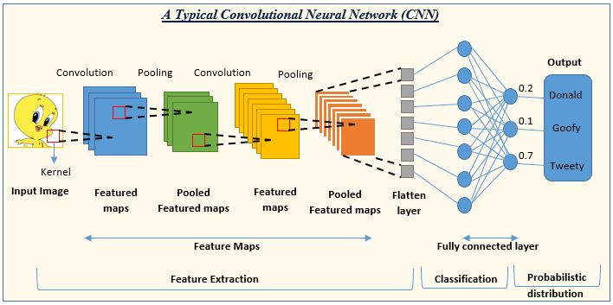
Methodology used
Image pre-processing: Improves image data by enhancing features, reducing noise, sharpening, and detecting edges.
CNN: Machine learning algorithm for image input, assigning importance to objects and differentiating them by extracting features.
Decision Trees: Intuitive visual tool for regression and classification, represented by a tree structure with attribute tests and class labels.

Slide 7
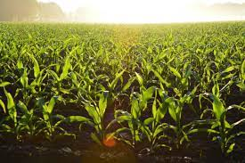
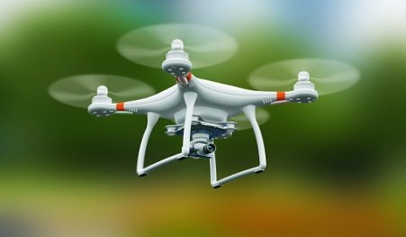
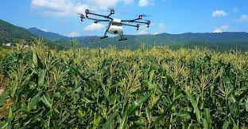
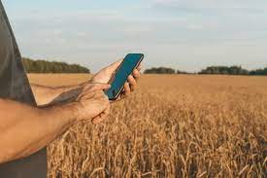
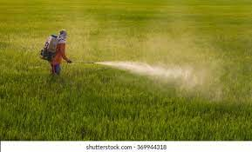
Experimental Setup
(1) Diseased farm land
(2) Drone
3) Surveying farm
(4) Farmer seeing analysis report land
(5) Spraying pesticides

Slide 8
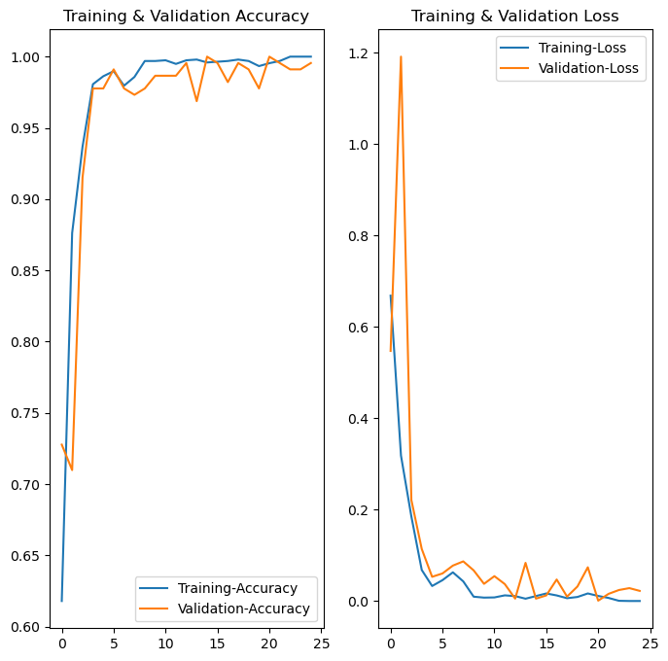
Results and Outputs
Value to farmers: Leveraging data and knowledge optimizes crop care, aiding farmers in nutrient provision and improving results.
Crop health improvement: Guiding farmers with data and knowledge optimizes nutrient delivery for healthier, stronger crops and increased productivity.
Empowering farmers: Providing beneficial guidance and information enables informed decisions, enhancing crop nutrition and overall success

Slide 9
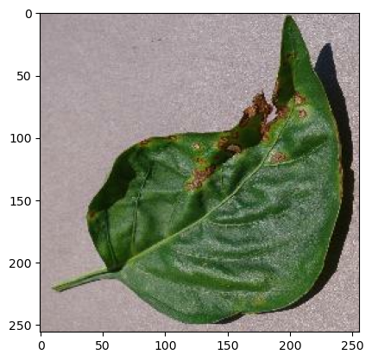
Conclusion
Predicted label: Pepper_bell_Bacterial_spot
Data and predictions: Processed data aids farmers by accurately predicting diseases and providing early-stage precautions.
Efficiency: Comprehensive surveys enable efficient decision-making, maximizing outcomes for farmers and benefiting society.
Technology meets tradition: The synergy of modern technology and traditional practices creates remarkable global impacts and wonders.

Slide 10
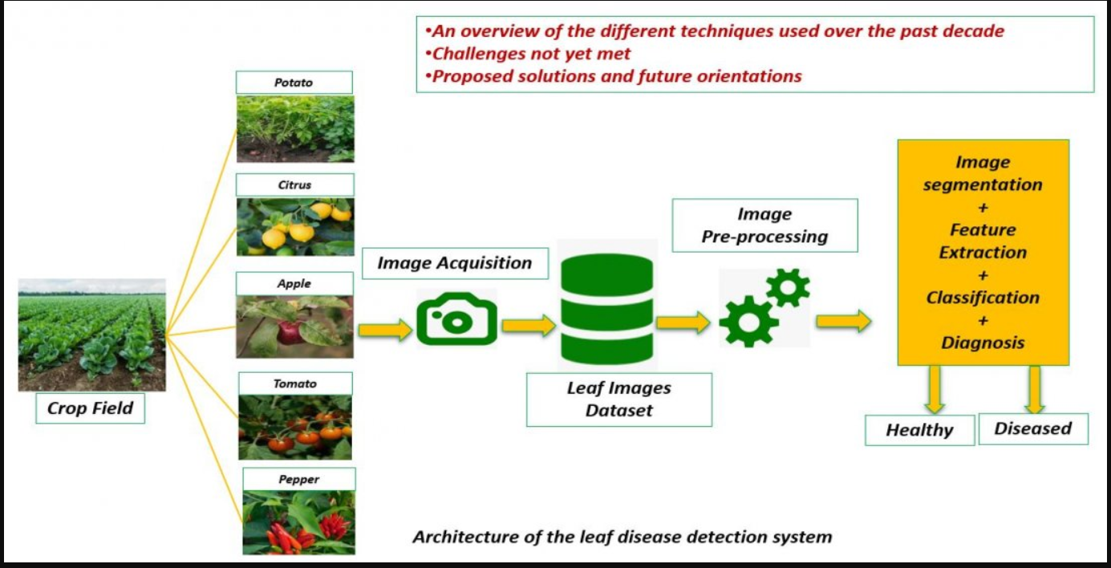
Future Scope
Efficient techniques combined for higher accuracy and market significance, improving our product's performance.
Diverse dataset analysis yields valuable crop information for implementation in any field, enabling us to meet farmers' demands comprehensively.
Focus on accuracy, efficiency, and versatility in delivering solutions to farmers, with ongoing efforts for continuous improvement and expanded applications.

Slide 11
References
[1]https://www.wikipedia.com
[2] https://www.frontiersin.org/articles/10.3389/fpls.2016.01419/full
[3] https://ieeexplore.ieee.org/stamp/stamp.jsp?arnumber=9142151
[4] https://www.sciencedirect.com/science/article/pii/S266592712100003
[5] https://www.researchgate.net/publication/340896870_Identification_of_Corn_Leaf_Disease_Based_on_Image_Processing
[6]https://www.intechopen.com/chapters/8149

